Slide 1
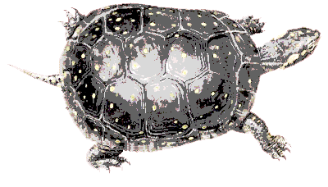
Turtle Diagram
WHAT: Equipment & Materials
A
B
C
WHO: Personnel & Competencies
A
B
C
KEY INPUTS
KEY OUTPUTS
A
B
C
Process X:
[Process Title]
A
B
C
HOW: Documentation or Method
A
B
C
CRITERIA: Objectives & Targets
A
B
C

Slide 2
SIPOC Diagram
SIP C
SUPPLIERS
INPUTS
PROCESS
OUTPUTS
CUSTOMERS
A
B
C
A
B
C
Process X:
[Process Title]
A
B
C
A
B
C
 | S Supplier | I Input | P Process | O Output | C Customer
Environment |  |  | Step 1 Step 2 Step 3 …
Man
Method
Measure
Machine
Material
Other

Slide 3
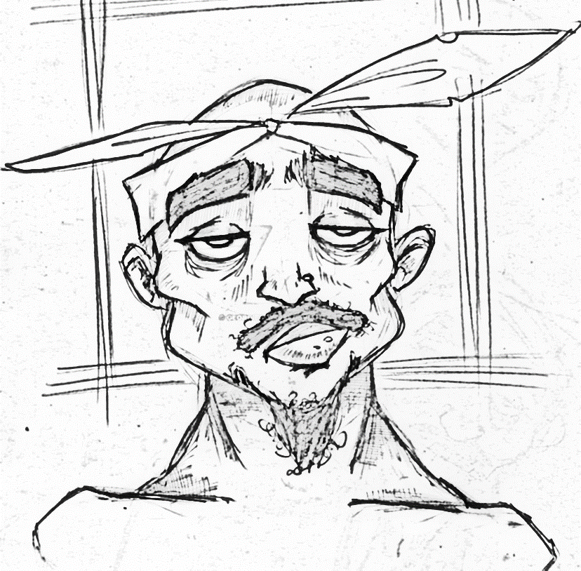
Tu-Poc Diagram
Suppliers:
A
B
C
Customers:
A
B
C
WHAT: Equipment & Materials
A
B
C
WHO: Personnel & Competencies
A
B
C
KEY INPUTS
KEY OUTPUTS
A
B
C
Process X:
[Process Title]
A
B
C
HOW: Documentation or Method
A
B
C
CRITERIA: Objectives & Targets
A
B
C

Slide 4
Tu-Poc Diagram + Risk Analysis
Suppliers:
A
B
C
TIP:
Individual process stakeholders vote on top risks & opportunities to satisfy requirements for (i.e. ISO 9001:2015 clause 4.4.1d, 6.1, etc.)
Customers:
A
B
C
1
2
3
= Top 3 Risks
1
2
3
= Top 3 Opportunities
WHAT: Equipment & Materials
A
B
C
WHO: Personnel & Competencies
A
B
C
KEY INPUTS
KEY OUTPUTS
A
B
C
Process X:
[Process Title]
A
B
C
HOW: Documentation or Method
A
B
C
CRITERIA: Objectives & Targets
A
B
C

